Slide 1


Slide 2
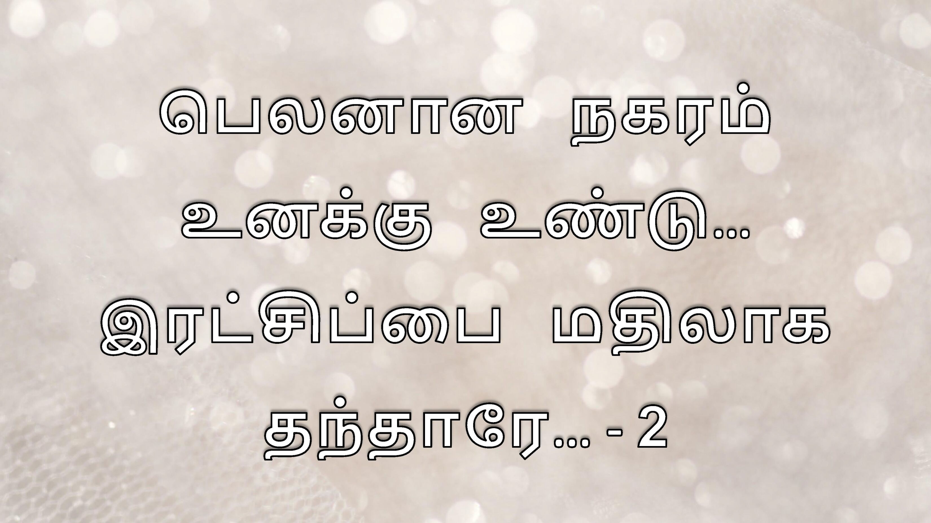

Slide 3
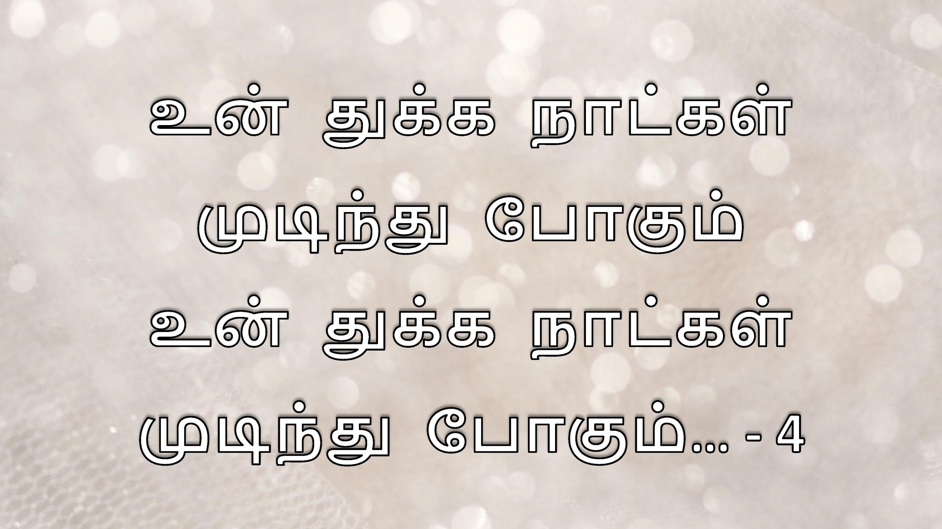

Slide 4
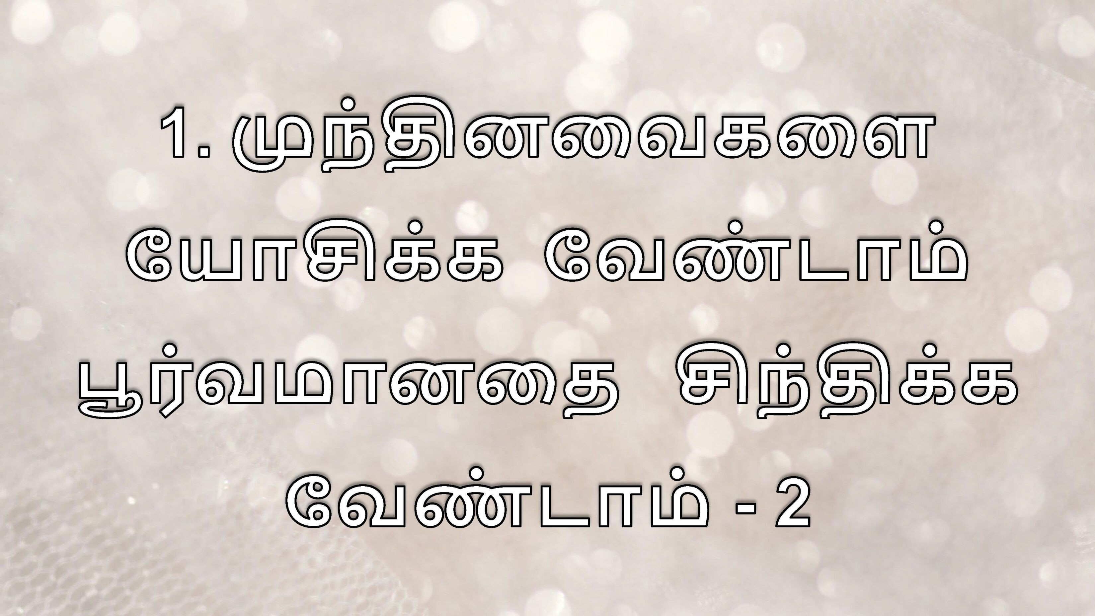

Slide 5
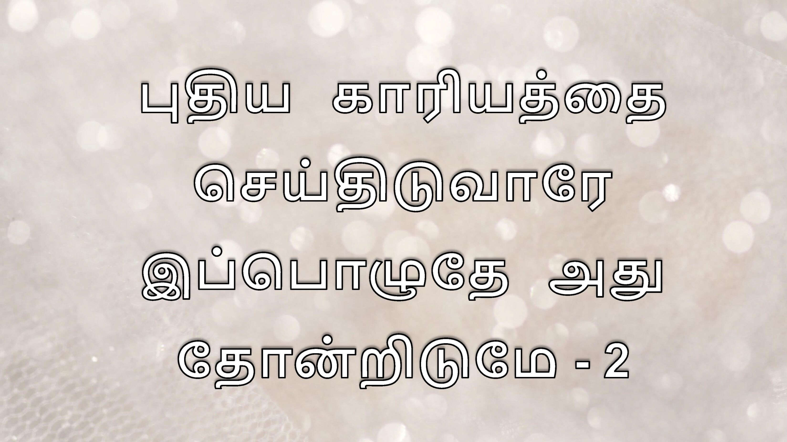
www.ChristianSlaveTamil.in

Slide 7
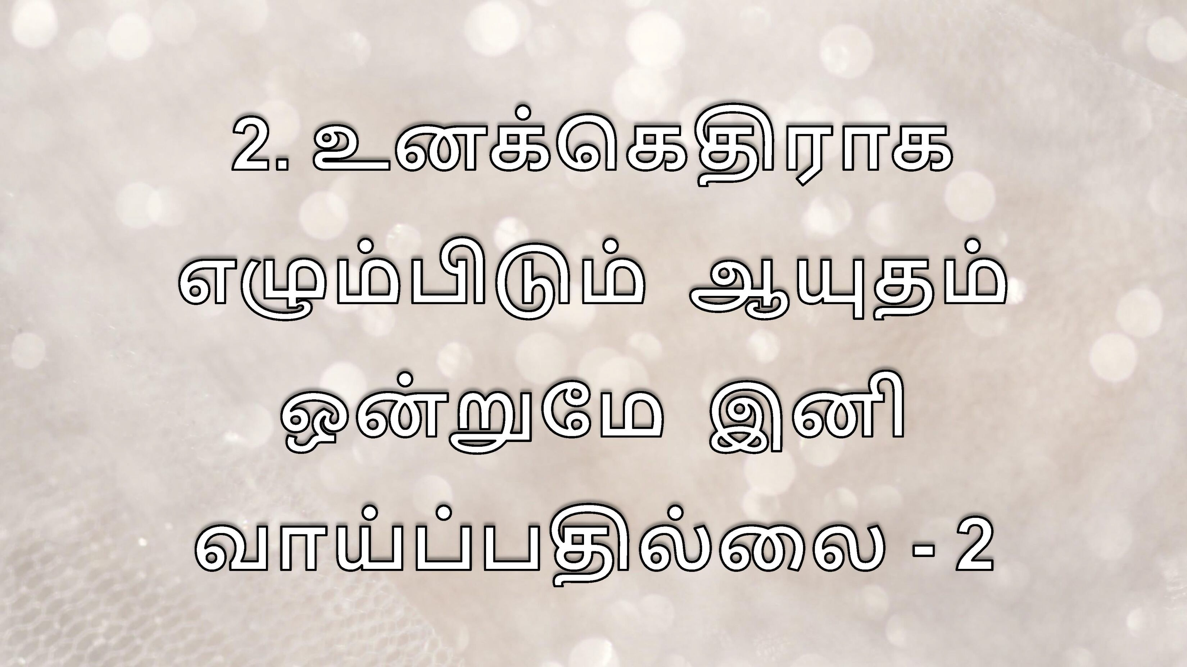

Slide 8
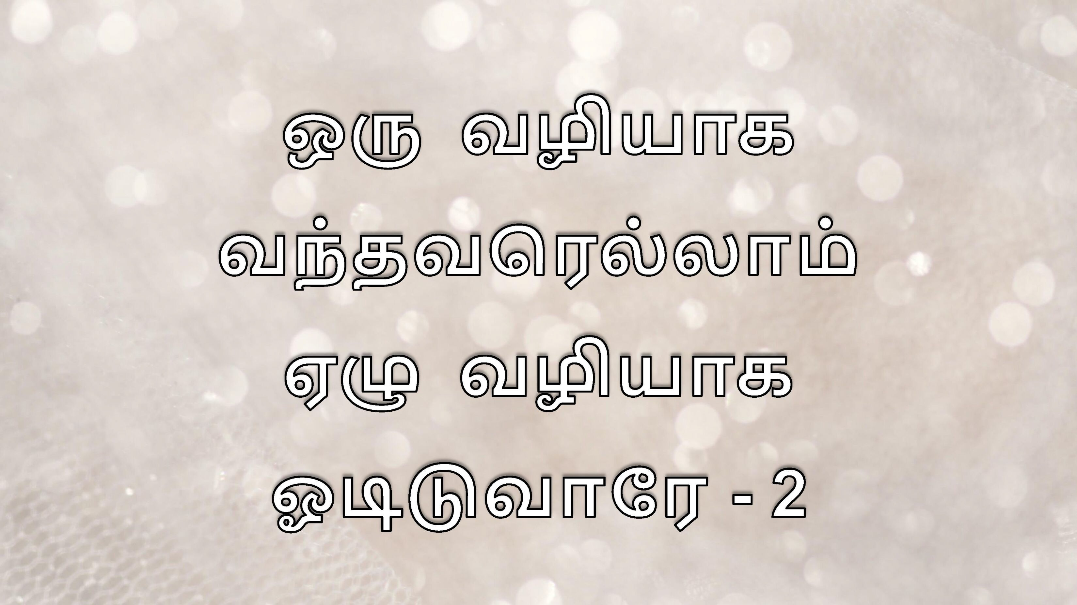
www.ChristianSlaveTamil.in

Slide 10
www.ChristianSlaveTamil.in

